Slide 1
SENTIMENT ANALYSIS USING RNN
SAARTHAK MAHAJAN

Slide 2
PROBLEM STATMENT
How can we teach a Neural Network?
Conversion of textual data.
Dimension of data.

Slide 3
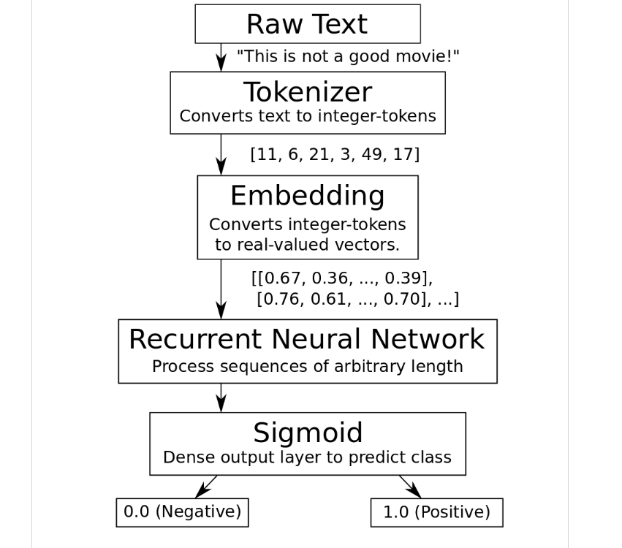

Slide 4
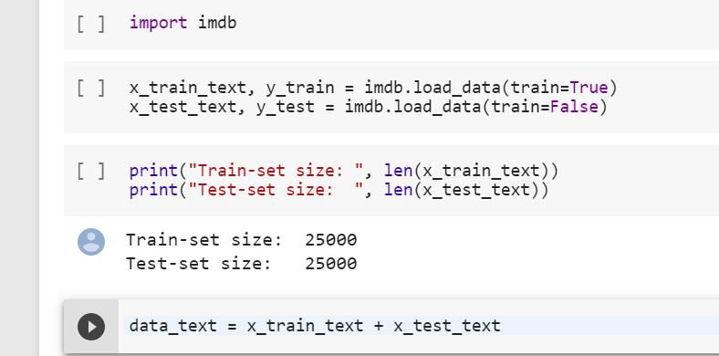
DATA SET – IMDB REVIEWS – 84MB DATA
25000 TRAIN, TEST
Andrew L. Maas, Raymond E. Daly, Peter T. Pham, Dan Huang, Andrew Y. Ng, and Christopher Potts. (2011). Learning Word Vectors for Sentiment Analysis. The 49th Annual Meeting of the Association for Computational Linguistics (ACL 2011).

Slide 5
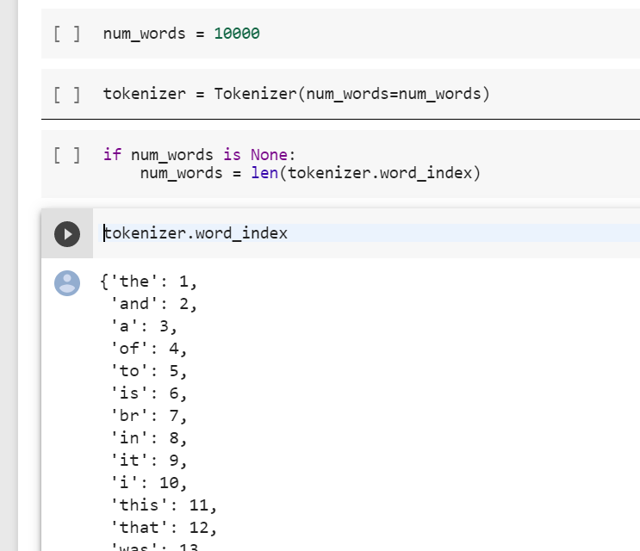
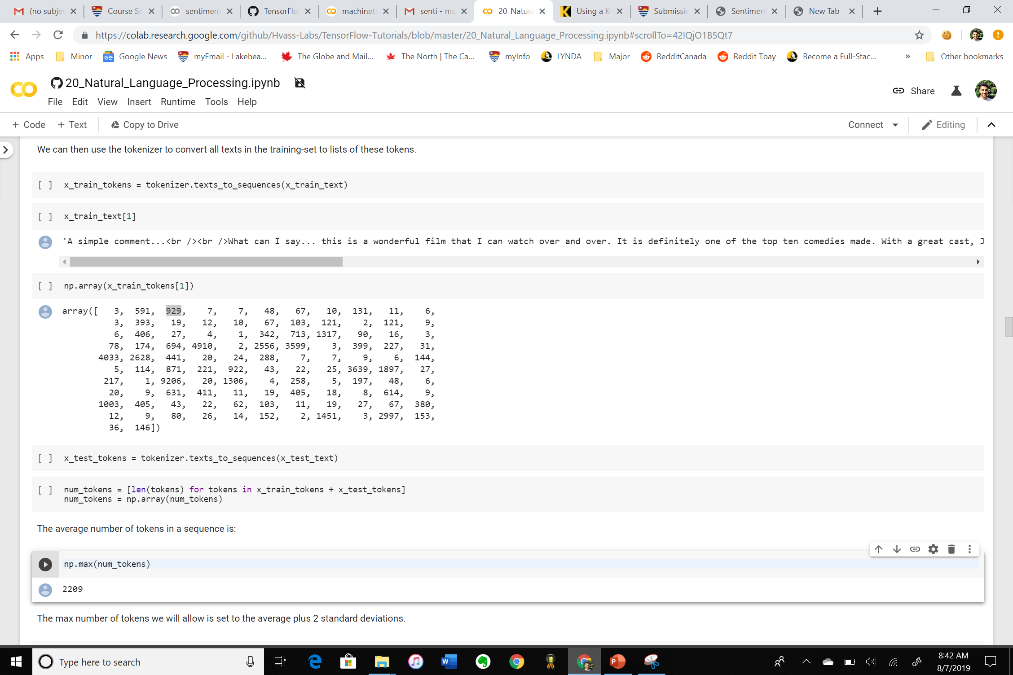
TOKENIZATION Convert text into integers

Slide 6


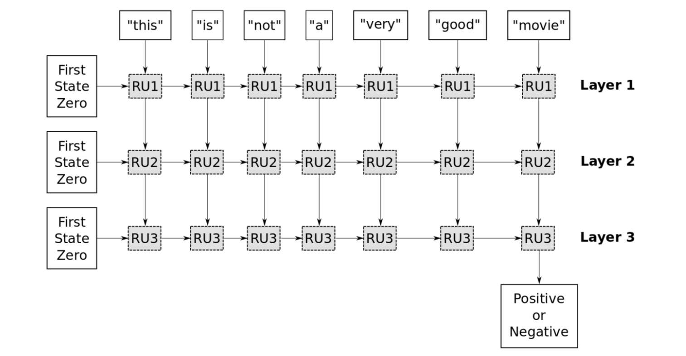




Slide 7
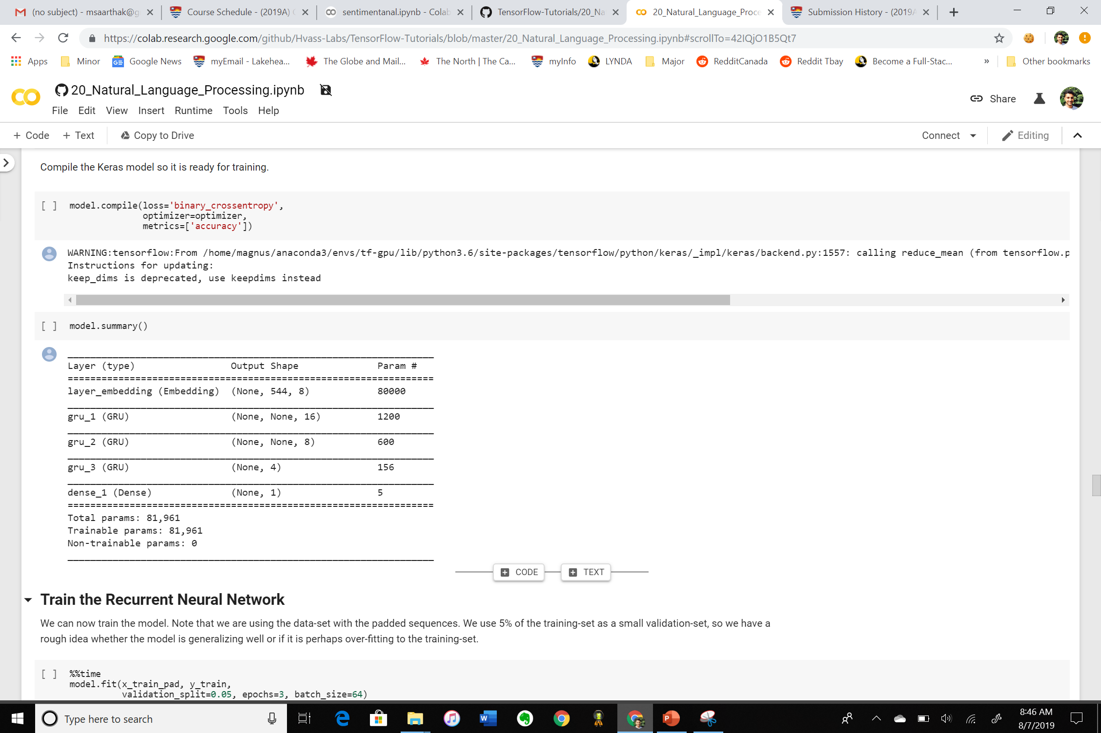
Neural network summary

Slide 8
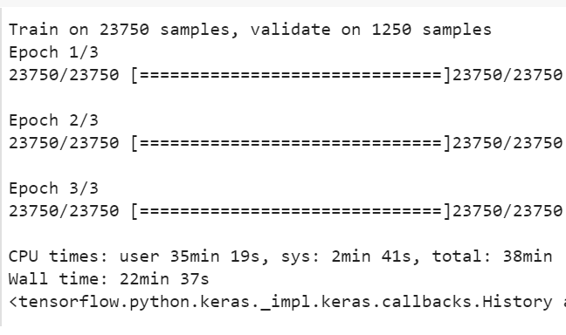
Model 1
Accuracy : 72.55%

Slide 9
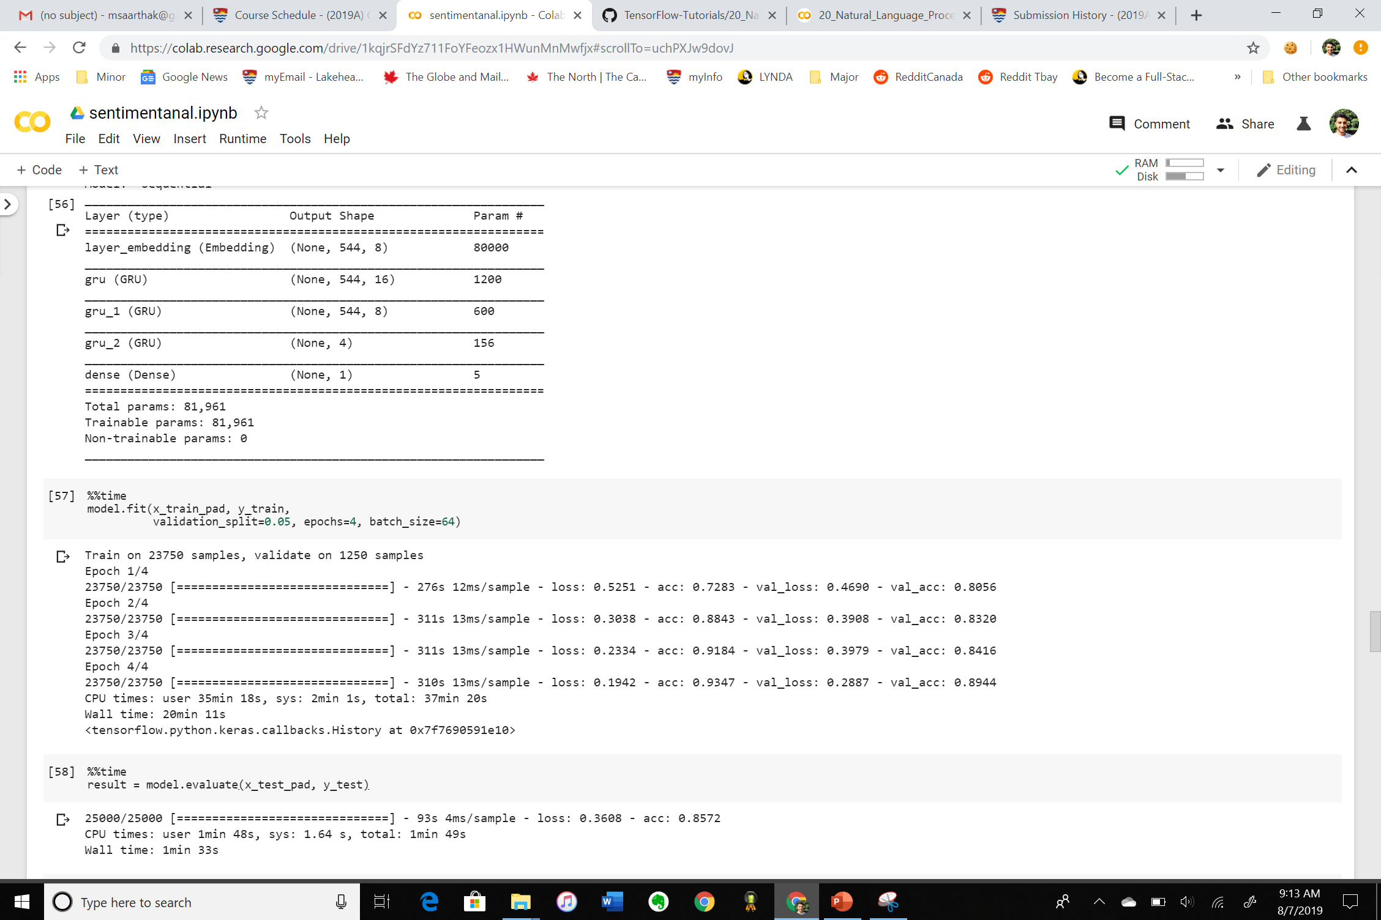
Model 2
Accuracy : 75.72%

Slide 10
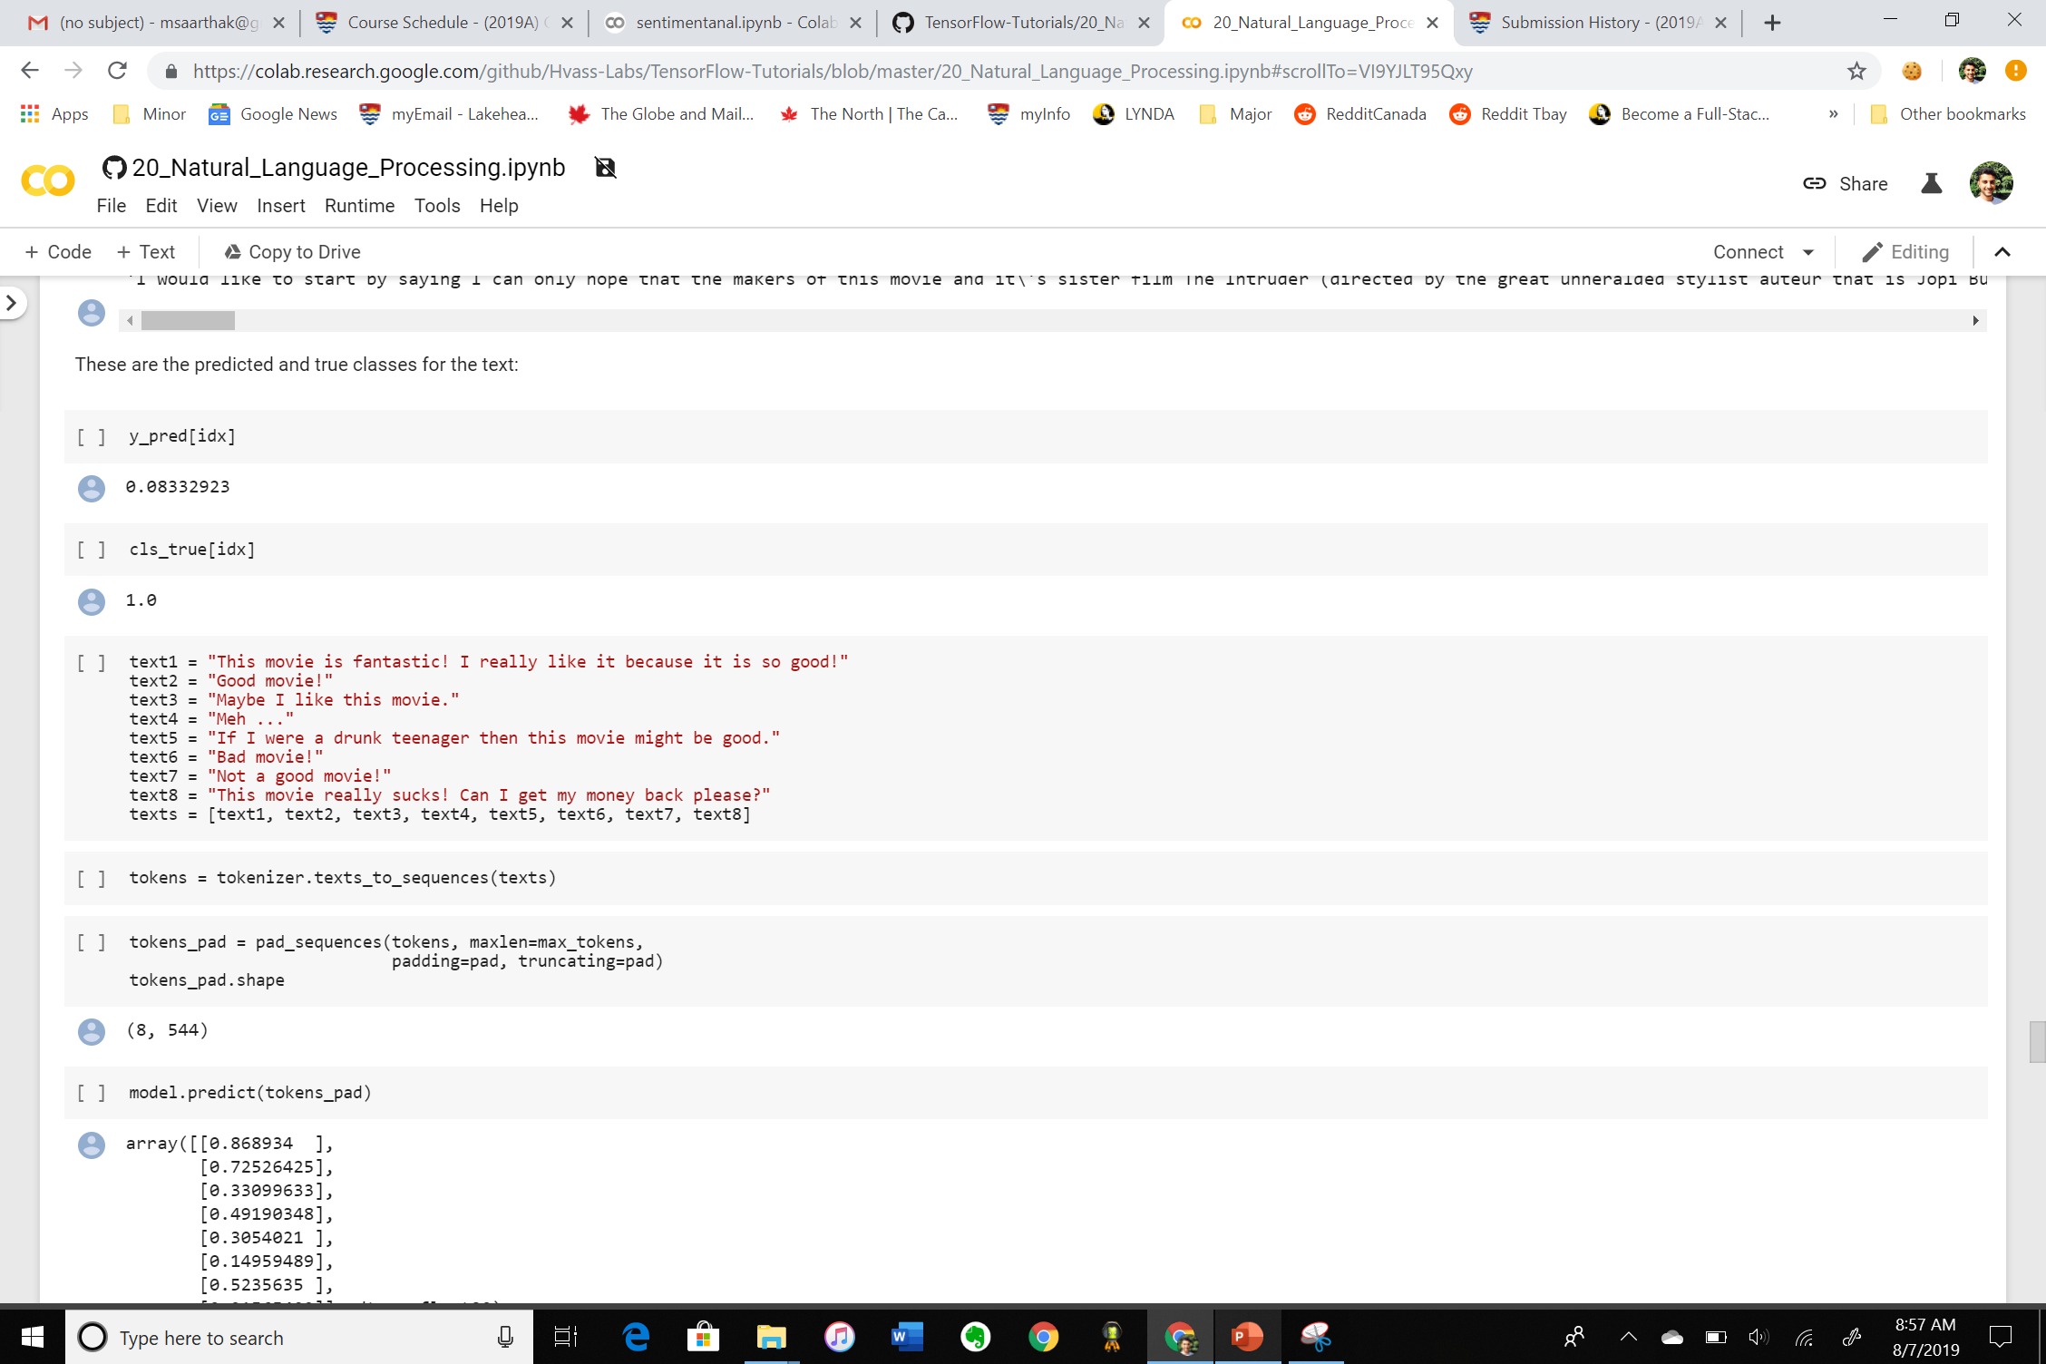
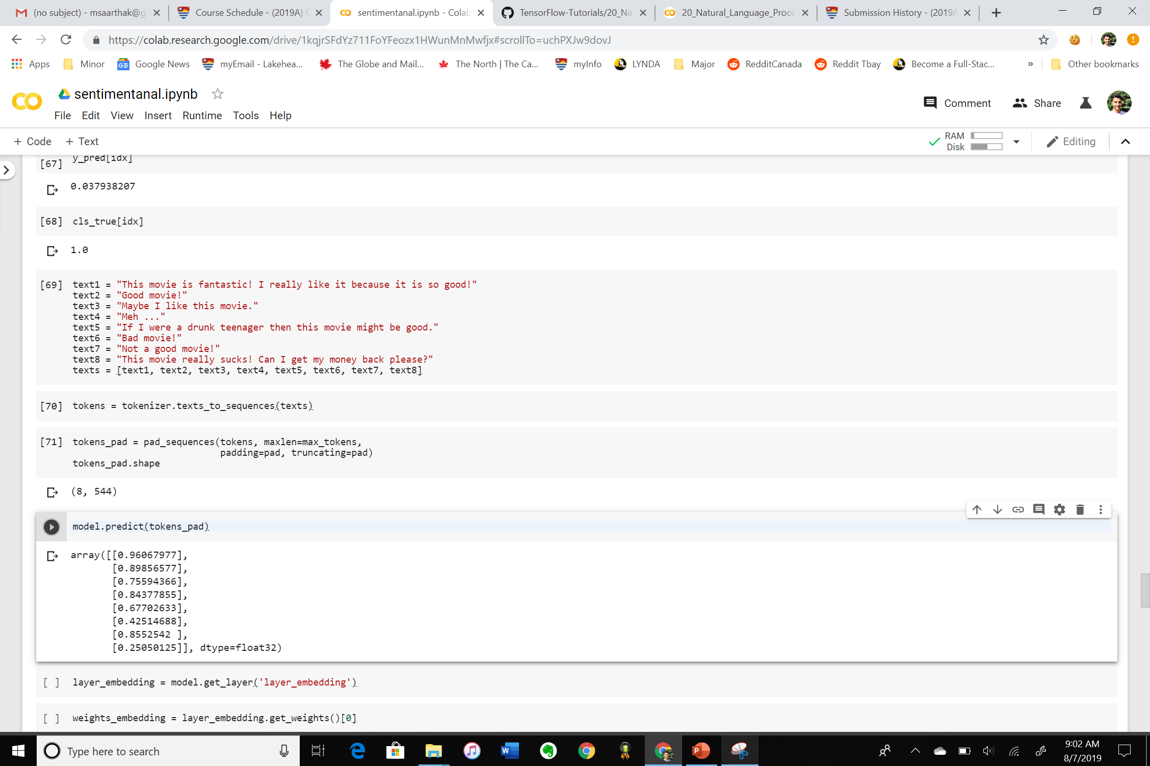
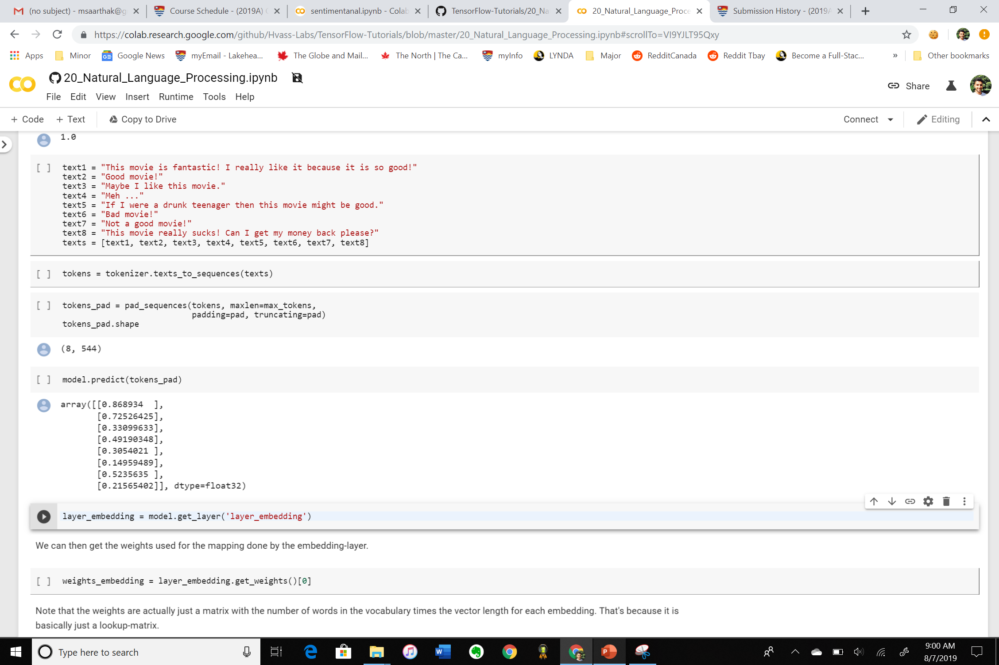
MODEL 1-
MODEL 1 – 72.55%
MODEL 2 – 75.72%

Slide 11
Conclusion

